Slide 1
DEALER ENERGY EFFICIENCY GUIDE
www.smmt.co.uk/dealerenergyefficiency
29 March 2011

Slide 2
Dealer Energy Efficiency Guide
Overview
Background
Survey
The Guide
Next steps

Slide 3
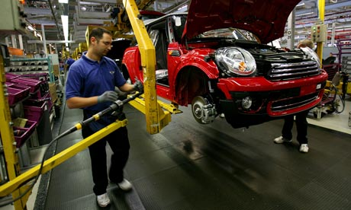
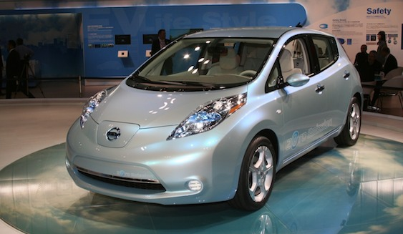
Dealer Energy Efficiency Guide
Background
30% reduction in CO₂ per vehicle in past decade
20% fall in average new car CO₂ emissions
Next…

Slide 4
Dealer Energy Efficiency Guide
Survey in conjunction with the Carbon Trust and RMI
30 dealers across UK visited.
Data on current energy use and opportunities for savings.
Dealers selected to be representative of activity and brands.
Dealers on average used:
740,000 kWh energy per annum
240tCO₂
£40,000 of energy

Slide 5
Dealer Energy Efficiency Guide
Saving potential
25% or £10,000 per annum at a dealer.
10% or £4,000 from no cost measures.
60% savings identified at one dealer.
Net potential for 5,000 dealers:
300,000tCO₂
£50 million off energy bills

Slide 6
Dealer Energy Efficiency Guide
The Guide
Highlights benefits of energy efficiency.
Provides:
Seven step action plan, in detail.
Top five recommendations on energy saving.
Break down of energy efficiency measures, by activity/level of investment.
Case studies.
Breakdown on energy use across survey sample.
Further information sources.
How to get Carbon Trust support.
www.smmt.co.uk/dealerenergyefficiency

Slide 7
Dealer Energy Efficiency Guide
Top five recommendations on saving energy
1 | Lighting. Switch off lamps when not in use. Make better use of natural light. When lamps/fluorescent tubes fail replace with more efficient equivalents including upgrading to LED or Compact Fluorescents (CFL).
2 | Heating/Hot Water. Switch off when not in use. Close doors. Switch to radiant heating in workshops and parts. Insulate and maintain buildings.
3 | Settings and controls. Ensure controls are set correctly for time, temperature, fan speed and other factors. Install timers, movement sensors, shut-down switches.
4 | Compressed Air. Ensure air compressors are switched off overnight and regularly maintained. Repair leaks and ensure air intake is from outside.
5 | Monitoring & Targeting. Collect and monitor energy and other data. Set realistic targets for reduction. Detect and resolve anomalies in energy consumption. Act on findings.

Slide 8
Dealer Energy Efficiency Guide
Seven step action plan
Step 1 | Appoint an Energy Champion. Appoint an appropriate person to drive energy management and provide management support.
Step 2 | Develop an Energy Policy. Produce a written energy policy for the Group or site which is communicated to all employees.
Step 3 | Identify Meters and Invoices. Identify location of all utility meters and gain regular access to all utility invoices.
Step 4 | Monitor and Target Energy Use. Read meters regularly, plot consumption, check usage against targets, identify waste and take corrective action.
Step 5 | Conduct Regular Energy Walkabouts. Identifying and recording energy waste, maintenance issues and opportunities for no cost, low cost and investment measures.
Step 6 | Implement Energy Saving Measures. Act on findings and implement saving measures.
Step 7 | Engage Employees and the Public. Regularly raise staff awareness, gain support/ideas, train key people and provide regular feedback on progress toward targets. Communicate objectives and successes with the public.

Slide 9
Dealer Energy Efficiency Guide
Next steps
Report available online – www.smmt.co.uk/dealerenergyefficiency
Website also contains summary, video, updates.
Industry to communicate website and guide to dealers.
Further training, support and information.
SMMT webinar on 7 April.
More events later in the year – check website for information.
Contact – energyefficiency@smmt.co.uk

Slide 10
www.smmt.co.uk/dealerenergyefficiency

