Slide 1
SMMT Brexit Readiness Webinar
Sydney Nash, Senior Policy Manager, SMMT

Slide 2
During presentations everyone will be muted so that only the presenters will be heard.
The presentation will be followed by a Q&A session. Please type your question into the side panel.
If you are experiencing any technical problems please call
020 7344 1673.

Slide 3
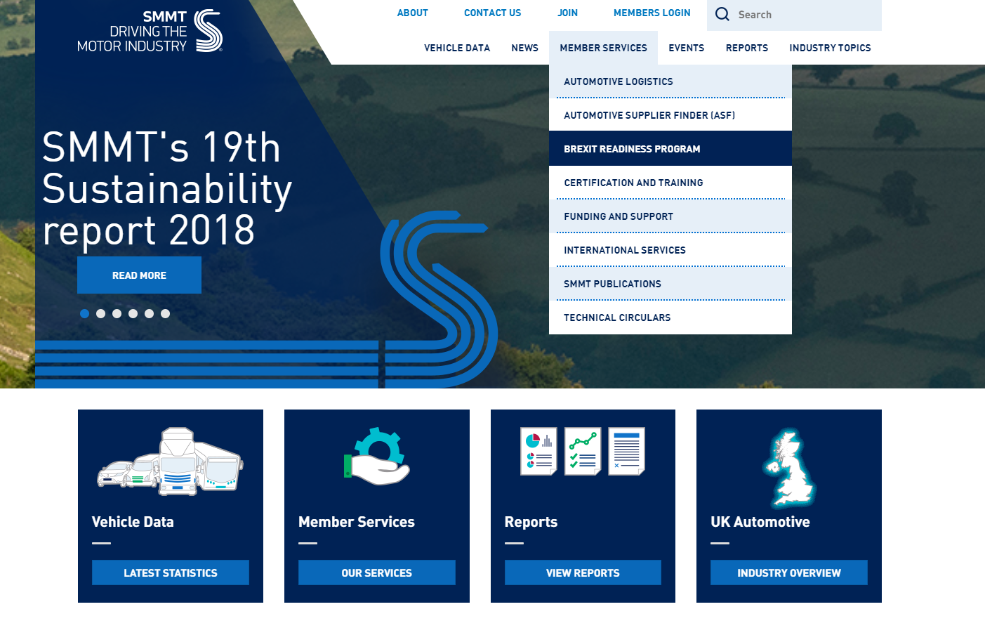
SMMT Brexit Readiness Programme

Slide 4
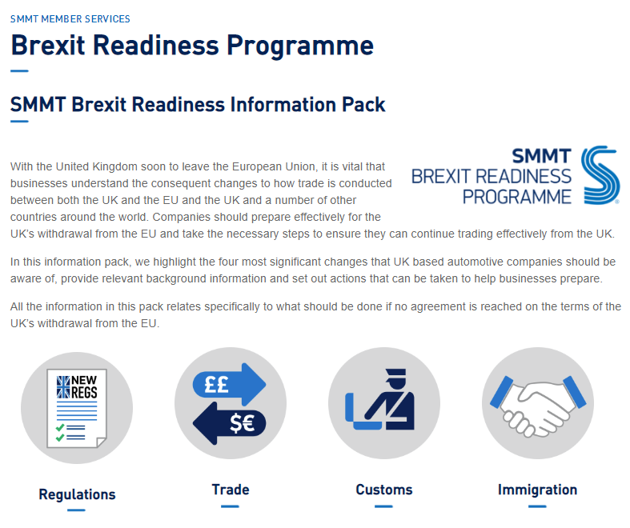
SMMT Brexit Readiness Programme

Slide 5
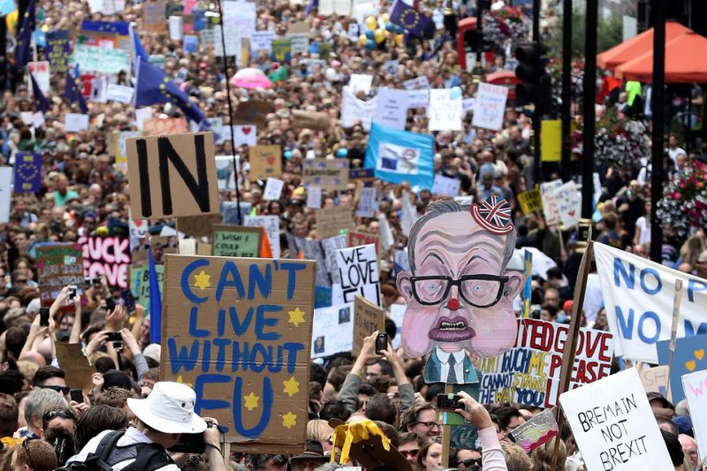
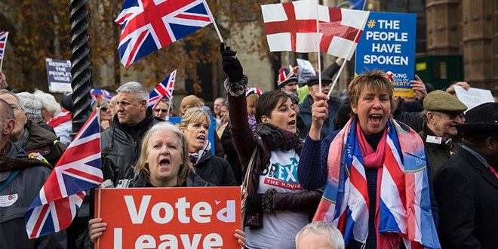
THE BREXIT DEBATE

Slide 6
TWITTERPLOMACY
935,000 #Brexit tweets during the 2017 general election campaign alone

Slide 7
BREXIT LEXICON
Super Canada
Hard Brexit
Soft Brexit
Leaver
Remainiac
WTO Terms
Remainer
Brexiteer
Canada +++
Canada +
No-Deal
Remoaner
Brexidus
Brexpert
Frictionless
Norway
Article 50
Backstop
Cherry Picking
Chequers
ERG

Slide 8
ANYONE FOR HOCKEY?

Slide 9
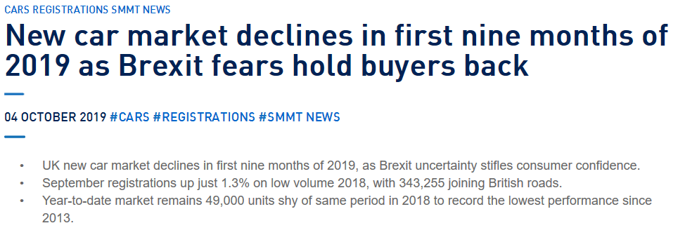
COST OF UNCERTAINTY

Slide 10
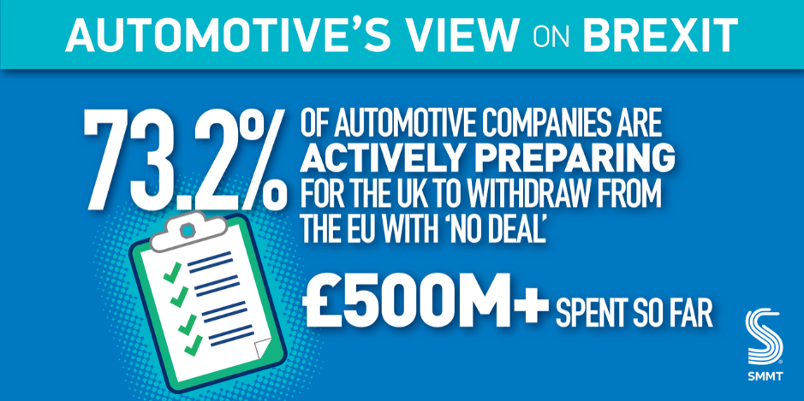
COST OF THE NO-DEAL THREAT

Slide 11
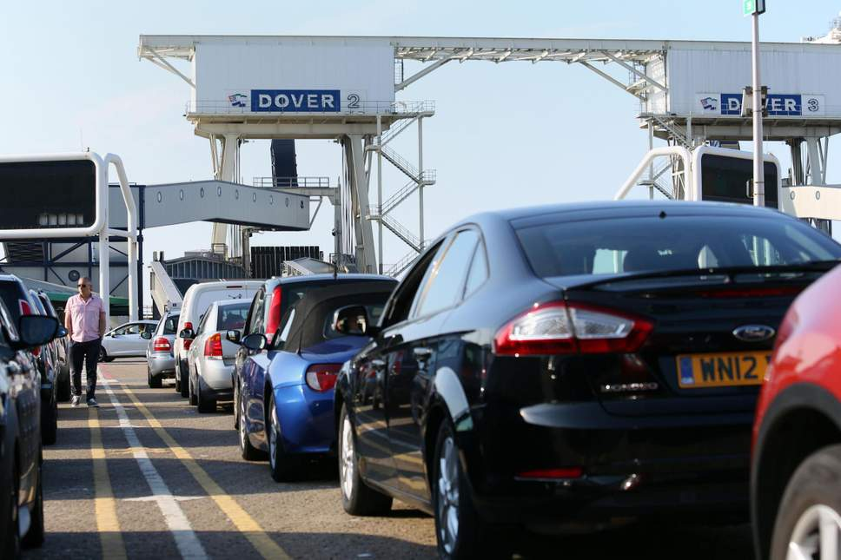
AUTOMOTIVE PRIORITIES
Government must agree the Withdrawal Agreement with the EU as soon as possible, rule out a ‘no-deal’ Brexit and secure the transition
Secure the benefits of single market, maintain regulatory harmonisation and avoid non-tariff barriers.
Remain in the customs union to guarantee the free flow of goods across the border.
Retain the ability to access talent freely and from across the EU.
Securing existing preferential trading arrangements with third country markets.

Slide 12
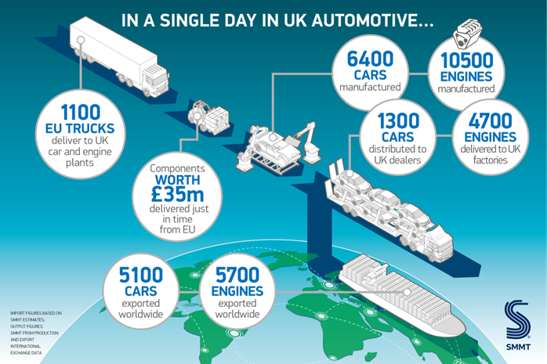
A HIGHLY INTEGRATED SECTOR

Slide 13
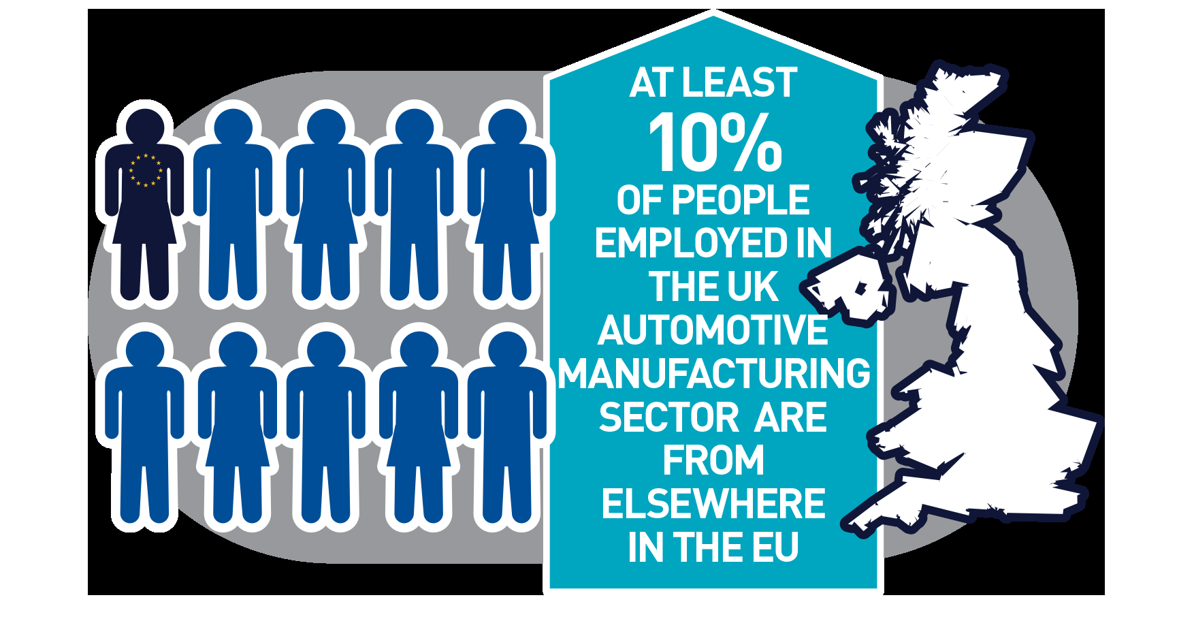
A EUROPEAN WORKFORCE

Slide 14
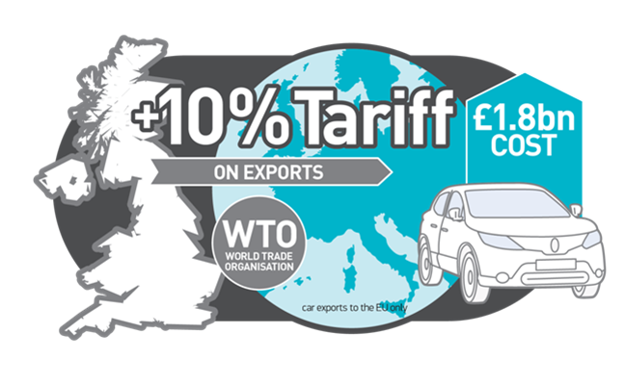
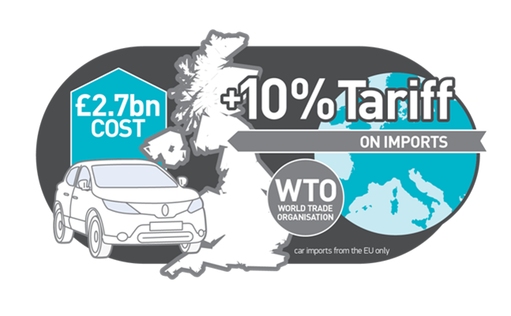
BREXIT RISKS

Slide 15
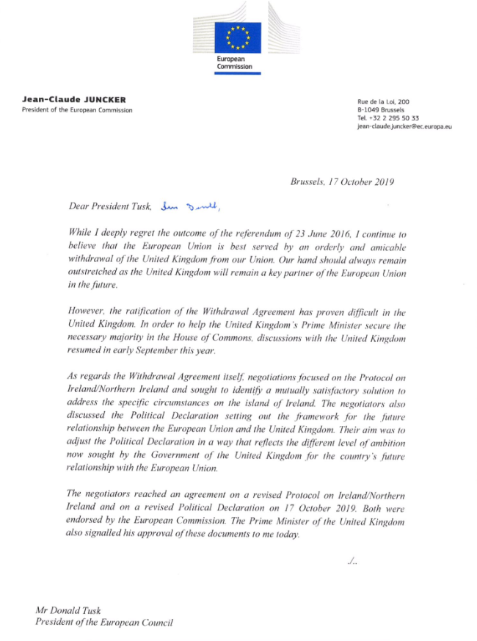
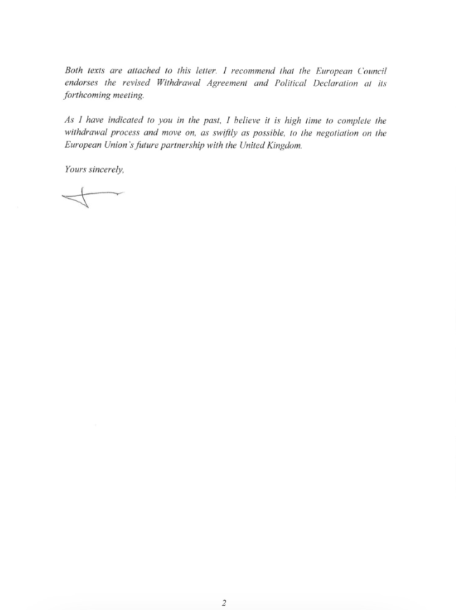
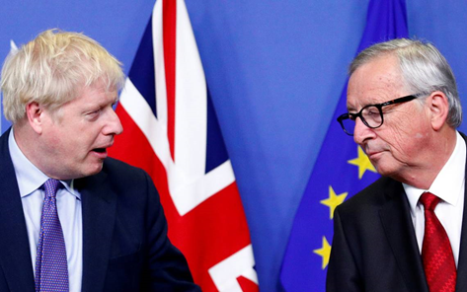
THE NEW BREXIT DEAL
Withdrawal Agreement
New Protocol on Ireland/Northern Ireland
Replaces backstop with “front-stop”
NI in UK customs territory, but operates as though in the EU’s customs union
No checks or new border infrastructure on the island of Ireland, but changes to East/West trade between NI and Great Britain
New consent mechanism introduced.
Impact for Automotive: Creates the conditions for a “hard Brexit” for Great Britain
Notes:
The European Commission and UK government announced on Thursday 17 October that they had reached agreement on a new Brexit deal. A revised Ireland/Northern Ireland Protocol has been published. This replaces the existing Protocol in the original Withdrawal Agreement and is the only change to the Withdrawal Agreement. Aside from this all other elements of the Withdrawal Agreement remain the same. A revised Political Declaration (PD) has also been published. The vast majority of it is unchanged, but where changes have been made, they matter to us. The key points are that: 1. The PD explicitly states that the UK and the EU will agree an FTA (see para 3, 17 and 19). All references to a free trade area have been removed (with the exception of one in para 21, which may be an oversight); 2. The level of ambition on rules of origin has reduced. The original political declaration committed to steps that “obviates the need for checks on rules of origin”. The new text states that there will be “appropriate and modern rules of origin”. So it is now clear that there will be rules of origin in relation to future UK/EU trade which is a logical consequence of government’s desire to have a free trade agreement. This does not, however, rule out the UK and the EU agreeing in the future relationship full cumulation; 3. The level of ambition on goods has been reduced. The original agreement envisaged “a trading relationship on goods that is as close as possible”. The new draft (para 19) states –“The Parties envisage having an ambitious trading relationship on goods on the basis of a Free Trade Agreement”. 4. There is a commitment to agree an FTA by the end of 2020. No change is being made to the timeline for the negotiating the future relationship. This means that transition will end at the end of next year, unless both parties agree to extending it (a maximum one off extension of two years is provided for in the Withdrawal Agreement), with the deadline for doing so being July next year. Part V of the new Political Declaration sets out in more detail than the original draft, the process for taking forward phase two of the negotiations. 5. The level playing field sections has been strengthen. This now includes a new justification (the geographic proximity and economic interdependence of the two parties), new references to tax, and the elevation of EU law as being one of the two pillars upon which the level playing field will sit (the other being international law).

Slide 16
THE NEW BREXIT DEAL
Withdrawal Agreement
Transition Period (Part 4)
Remains unchanged
Ends 31 December 2020 (Art. 126)
Can be extended, but only once (Art 132)
Extension can be for one or two years
Decision to extend must be made by 1st July 2020
Govt. committed to completing a deal by Dec 2020
Impact for Automotive: Risk of rushed deal and further “cliff-edge” moments.
Notes:
The European Commission and UK government announced on Thursday 17 October that they had reached agreement on a new Brexit deal. A revised Ireland/Northern Ireland Protocol has been published. This replaces the existing Protocol in the original Withdrawal Agreement and is the only change to the Withdrawal Agreement. Aside from this all other elements of the Withdrawal Agreement remain the same. A revised Political Declaration (PD) has also been published. The vast majority of it is unchanged, but where changes have been made, they matter to us. The key points are that: 1. The PD explicitly states that the UK and the EU will agree an FTA (see para 3, 17 and 19). All references to a free trade area have been removed (with the exception of one in para 21, which may be an oversight); 2. The level of ambition on rules of origin has reduced. The original political declaration committed to steps that “obviates the need for checks on rules of origin”. The new text states that there will be “appropriate and modern rules of origin”. So it is now clear that there will be rules of origin in relation to future UK/EU trade which is a logical consequence of government’s desire to have a free trade agreement. This does not, however, rule out the UK and the EU agreeing in the future relationship full cumulation; 3. The level of ambition on goods has been reduced. The original agreement envisaged “a trading relationship on goods that is as close as possible”. The new draft (para 19) states –“The Parties envisage having an ambitious trading relationship on goods on the basis of a Free Trade Agreement”. 4. There is a commitment to agree an FTA by the end of 2020. No change is being made to the timeline for the negotiating the future relationship. This means that transition will end at the end of next year, unless both parties agree to extending it (a maximum one off extension of two years is provided for in the Withdrawal Agreement), with the deadline for doing so being July next year. Part V of the new Political Declaration sets out in more detail than the original draft, the process for taking forward phase two of the negotiations. 5. The level playing field sections has been strengthen. This now includes a new justification (the geographic proximity and economic interdependence of the two parties), new references to tax, and the elevation of EU law as being one of the two pillars upon which the level playing field will sit (the other being international law).

Slide 17
THE NEW BREXIT DEAL
Withdrawal Agreement
Additional Transition Provisions
UK participation in EU committees & expert groups upon invitation (Art 128(5))
UK bound by EU FTAs (Art. 129(1))
UK can negotiate trade deals but these can only come into force after the transition unless the EU consents otherwise (Art. 129(4))
Impact for Automotive:
Opportunity to set precedent for UK participation, as a third country, in regulatory discussions.
Continuity of access to preferential trade
Notes:
The European Commission and UK government announced on Thursday 17 October that they had reached agreement on a new Brexit deal. A revised Ireland/Northern Ireland Protocol has been published. This replaces the existing Protocol in the original Withdrawal Agreement and is the only change to the Withdrawal Agreement. Aside from this all other elements of the Withdrawal Agreement remain the same. A revised Political Declaration (PD) has also been published. The vast majority of it is unchanged, but where changes have been made, they matter to us. The key points are that: 1. The PD explicitly states that the UK and the EU will agree an FTA (see para 3, 17 and 19). All references to a free trade area have been removed (with the exception of one in para 21, which may be an oversight); 2. The level of ambition on rules of origin has reduced. The original political declaration committed to steps that “obviates the need for checks on rules of origin”. The new text states that there will be “appropriate and modern rules of origin”. So it is now clear that there will be rules of origin in relation to future UK/EU trade which is a logical consequence of government’s desire to have a free trade agreement. This does not, however, rule out the UK and the EU agreeing in the future relationship full cumulation; 3. The level of ambition on goods has been reduced. The original agreement envisaged “a trading relationship on goods that is as close as possible”. The new draft (para 19) states –“The Parties envisage having an ambitious trading relationship on goods on the basis of a Free Trade Agreement”. 4. There is a commitment to agree an FTA by the end of 2020. No change is being made to the timeline for the negotiating the future relationship. This means that transition will end at the end of next year, unless both parties agree to extending it (a maximum one off extension of two years is provided for in the Withdrawal Agreement), with the deadline for doing so being July next year. Part V of the new Political Declaration sets out in more detail than the original draft, the process for taking forward phase two of the negotiations. 5. The level playing field sections has been strengthen. This now includes a new justification (the geographic proximity and economic interdependence of the two parties), new references to tax, and the elevation of EU law as being one of the two pillars upon which the level playing field will sit (the other being international law).

Slide 18
THE NEW BREXIT DEAL
Withdrawal Agreement
Goods on the Market (Pt. 3 Title 1)
Provides for goods that are placed on the market before the end of transition to continue in free circulation in both markets after the transition (Art. 41)
Burden of proof sit with business (Art. 42)
Good must be physically on the market (not just ordered or in production) (Art. 40)
Impact for Automotive: Status quo provisions apply to all goods circulating before the end of transition. Most relevant if future trading terms are worse than existing terms.
Notes:
The European Commission and UK government announced on Thursday 17 October that they had reached agreement on a new Brexit deal. A revised Ireland/Northern Ireland Protocol has been published. This replaces the existing Protocol in the original Withdrawal Agreement and is the only change to the Withdrawal Agreement. Aside from this all other elements of the Withdrawal Agreement remain the same. A revised Political Declaration (PD) has also been published. The vast majority of it is unchanged, but where changes have been made, they matter to us. The key points are that: 1. The PD explicitly states that the UK and the EU will agree an FTA (see para 3, 17 and 19). All references to a free trade area have been removed (with the exception of one in para 21, which may be an oversight); 2. The level of ambition on rules of origin has reduced. The original political declaration committed to steps that “obviates the need for checks on rules of origin”. The new text states that there will be “appropriate and modern rules of origin”. So it is now clear that there will be rules of origin in relation to future UK/EU trade which is a logical consequence of government’s desire to have a free trade agreement. This does not, however, rule out the UK and the EU agreeing in the future relationship full cumulation; 3. The level of ambition on goods has been reduced. The original agreement envisaged “a trading relationship on goods that is as close as possible”. The new draft (para 19) states –“The Parties envisage having an ambitious trading relationship on goods on the basis of a Free Trade Agreement”. 4. There is a commitment to agree an FTA by the end of 2020. No change is being made to the timeline for the negotiating the future relationship. This means that transition will end at the end of next year, unless both parties agree to extending it (a maximum one off extension of two years is provided for in the Withdrawal Agreement), with the deadline for doing so being July next year. Part V of the new Political Declaration sets out in more detail than the original draft, the process for taking forward phase two of the negotiations. 5. The level playing field sections has been strengthen. This now includes a new justification (the geographic proximity and economic interdependence of the two parties), new references to tax, and the elevation of EU law as being one of the two pillars upon which the level playing field will sit (the other being international law).

Slide 19
THE NEW BREXIT DEAL
Political Declaration
UK and the EU will agree an FTA (paras 3, 17 and 19)
RoO ambition dropped (para 22) - Original committed to steps that “obviates the need for check on rules of origin”. New text states that there will be “appropriate and modern rules of origin”. Now clear that there will be RoO in relation to future UK/EU trade
Commitment to agree an FTA by the end of 2020 (para 135)
Notes:
The European Commission and UK government announced on Thursday 17 October that they had reached agreement on a new Brexit deal. A revised Ireland/Northern Ireland Protocol has been published. This replaces the existing Protocol in the original Withdrawal Agreement and is the only change to the Withdrawal Agreement. Aside from this all other elements of the Withdrawal Agreement remain the same. A revised Political Declaration (PD) has also been published. The vast majority of it is unchanged, but where changes have been made, they matter to us. The key points are that: 1. The PD explicitly states that the UK and the EU will agree an FTA (see para 3, 17 and 19). All references to a free trade area have been removed (with the exception of one in para 21, which may be an oversight); 2. The level of ambition on rules of origin has reduced. The original political declaration committed to steps that “obviates the need for checks on rules of origin”. The new text states that there will be “appropriate and modern rules of origin”. So it is now clear that there will be rules of origin in relation to future UK/EU trade which is a logical consequence of government’s desire to have a free trade agreement. This does not, however, rule out the UK and the EU agreeing in the future relationship full cumulation; 3. The level of ambition on goods has been reduced. The original agreement envisaged “a trading relationship on goods that is as close as possible”. The new draft (para 19) states –“The Parties envisage having an ambitious trading relationship on goods on the basis of a Free Trade Agreement”. 4. There is a commitment to agree an FTA by the end of 2020. No change is being made to the timeline for the negotiating the future relationship. This means that transition will end at the end of next year, unless both parties agree to extending it (a maximum one off extension of two years is provided for in the Withdrawal Agreement), with the deadline for doing so being July next year. Part V of the new Political Declaration sets out in more detail than the original draft, the process for taking forward phase two of the negotiations. 5. The level playing field sections has been strengthen. This now includes a new justification (the geographic proximity and economic interdependence of the two parties), new references to tax, and the elevation of EU law as being one of the two pillars upon which the level playing field will sit (the other being international law).

Slide 20
THE NEW BREXIT DEAL
Political Declaration
Level playing field sections has been strengthen (para 77). New justification (the geographic proximity and economic interdependence), references to tax, and elevation of EU law as being one of the two pillars upon which the level playing field will sit (the other being international law). But level playing field provisions in the Withdrawal Agreement
Impact for Automotive: Points towards a less ambitious future trading relationship. Regulatory sovereignty prioritised above frictionless trade.
Notes:
The European Commission and UK government announced on Thursday 17 October that they had reached agreement on a new Brexit deal. A revised Ireland/Northern Ireland Protocol has been published. This replaces the existing Protocol in the original Withdrawal Agreement and is the only change to the Withdrawal Agreement. Aside from this all other elements of the Withdrawal Agreement remain the same. A revised Political Declaration (PD) has also been published. The vast majority of it is unchanged, but where changes have been made, they matter to us. The key points are that: 1. The PD explicitly states that the UK and the EU will agree an FTA (see para 3, 17 and 19). All references to a free trade area have been removed (with the exception of one in para 21, which may be an oversight); 2. The level of ambition on rules of origin has reduced. The original political declaration committed to steps that “obviates the need for checks on rules of origin”. The new text states that there will be “appropriate and modern rules of origin”. So it is now clear that there will be rules of origin in relation to future UK/EU trade which is a logical consequence of government’s desire to have a free trade agreement. This does not, however, rule out the UK and the EU agreeing in the future relationship full cumulation; 3. The level of ambition on goods has been reduced. The original agreement envisaged “a trading relationship on goods that is as close as possible”. The new draft (para 19) states –“The Parties envisage having an ambitious trading relationship on goods on the basis of a Free Trade Agreement”. 4. There is a commitment to agree an FTA by the end of 2020. No change is being made to the timeline for the negotiating the future relationship. This means that transition will end at the end of next year, unless both parties agree to extending it (a maximum one off extension of two years is provided for in the Withdrawal Agreement), with the deadline for doing so being July next year. Part V of the new Political Declaration sets out in more detail than the original draft, the process for taking forward phase two of the negotiations. 5. The level playing field sections has been strengthen. This now includes a new justification (the geographic proximity and economic interdependence of the two parties), new references to tax, and the elevation of EU law as being one of the two pillars upon which the level playing field will sit (the other being international law).

Slide 21
THE NEW BREXIT DEAL
OBJECTIVE \ LEGAL FRAMEWORK | Tariffs | Customs | Regulatory Alignment | Regulatory Influence | People | Trade | R&D
Single Market + Customs Union (“EEA+ model”, “Norway+”, “Common Market 2.0”) | Delivered | Delivered | Delivered | Partially Delivered | Delivered | Likely, but untested | Delivered
May Deal + “Chequers” | Delivered | Objective = frictionless trade, but FCA undeliverable | Common rule book should deliver regulatory alignment on goods | Unknown (calls for formal consultation on regulatory issues) | Unknown (to be defined by the Immigration Bill) | Proposes continue cumulation of EU/UK content for purposes pf FTAs | Objective = “association in research and innovation programme, including Horizon Europe
Johnson Deal | Delivered | Not delivered – No frictionless trade for GB. New cost to GB/NI trade | Not delivered – Govt. prioritising divergence over the removal of friction | Not delivered – Regulatory influence will be lost if the UK priorities divergence | Unknown (to be defined by the Immigration Bill) | Trade deal replication remains govt. objective. Questions re RoO & replicating the affect | Unknown – Provisions to participate in R&D programmes remains. Not govt. priority
Labour Proposal (Customs Union plus some regulatory alignment) | Delivered | Possible, but number of essentially elements missing from proposal | Partially delivered | Partially delivered | Unknown | Possible, but untested | Delivered
Signatory to the EEA (“Norway Model”) | Partially Delivered (depending on rules of origin) | Partially Delivered (physical border with simplifications) | Delivered | Partially Delivered (ability to comment on proposals but not to vote) | Delivered | Not Delivered | Delivered
EFTA Member (“Swiss Model”) | Partially Delivered (depending on rules of origin) | Partially Delivered (physical border, simplifications) | Partially Delivered (no automatic alignment) | Partially Delivered (less than EEA) | Delivered | Not Delivered | Delivered
A Customs Union for industrial goods only (“Turkey model”) | Delivered | Partially Delivered (physical border, free circulation) | Partially Delivered (depending on the terms of a CU) | Not Delivered | Not Delivered | Not Delivered | Delivered
Association Agreement (“Ukraine model”) | Partially Delivered (depending on rules of origin) | Not Delivered | Partially Delivered (depending on the terms of an AA) | Not Delivered | Not Delivered | Not Delivered | Delivered
FTA (“Canada Model”) | Partially Delivered (depending on rules of origin) | Not Delivered | Not Delivered (but partial mutual recognition possible) | Not Delivered | Not Delivered | Not Delivered | Not Delivered
WTO Rules (“no-deal”) | Not Delivered | Not Delivered | Not Delivered | Not Delivered | Not Delivered | Not Delivered | Not Delivered

Slide 22
THE NEW BREXIT DEAL
OBJECTIVE \ LEGAL FRAMEWORK | Tariffs | Customs | Regulatory Alignment | Regulatory Influence | People | Trade | R&D
Single Market + Customs Union (“EEA+ model”, “Norway+”, “Common Market 2.0”) | Delivered | Delivered | Delivered | Partially Delivered | Delivered | Likely, but untested | Delivered
May Deal + “Chequers” | Delivered | Objective = frictionless trade, but FCA undeliverable | Common rule book should deliver regulatory alignment on goods | Unknown (calls for formal consultation on regulatory issues) | Unknown (to be defined by the Immigration Bill) | Proposes continue cumulation of EU/UK content for purposes pf FTAs | Objective = “association in research and innovation programme, including Horizon Europe
Johnson Deal | Delivered | Not delivered – No frictionless trade for GB. New cost to GB/NI trade | Not delivered – Govt. prioritising divergence over the removal of friction | Not delivered – Regulatory influence will be lost if the UK priorities divergence | Unknown (to be defined by the Immigration Bill) | Trade deal replication remains govt. objective. Questions re RoO & replicating the affect | Unknown – Provisions to participate in R&D programmes remains. Not govt. priority
Labour Proposal (Customs Union plus some regulatory alignment) | Delivered | Possible, but number of essentially elements missing from proposal | Partially delivered | Partially delivered | Unknown | Possible, but untested | Delivered
Signatory to the EEA (“Norway Model”) | Partially Delivered (depending on rules of origin) | Partially Delivered (physical border with simplifications) | Delivered | Partially Delivered (ability to comment on proposals but not to vote) | Delivered | Not Delivered | Delivered
EFTA Member (“Swiss Model”) | Partially Delivered (depending on rules of origin) | Partially Delivered (physical border, simplifications) | Partially Delivered (no automatic alignment) | Partially Delivered (less than EEA) | Delivered | Not Delivered | Delivered
A Customs Union for industrial goods only (“Turkey model”) | Delivered | Partially Delivered (physical border, free circulation) | Partially Delivered (depending on the terms of a CU) | Not Delivered | Not Delivered | Not Delivered | Delivered
Association Agreement (“Ukraine model”) | Partially Delivered (depending on rules of origin) | Not Delivered | Partially Delivered (depending on the terms of an AA) | Not Delivered | Not Delivered | Not Delivered | Delivered
FTA (“Canada Model”) | Partially Delivered (depending on rules of origin) | Not Delivered | Not Delivered (but partial mutual recognition possible) | Not Delivered | Not Delivered | Not Delivered | Not Delivered
WTO Rules (“no-deal”) | Not Delivered | Not Delivered | Not Delivered | Not Delivered | Not Delivered | Not Delivered | Not Delivered

Slide 23
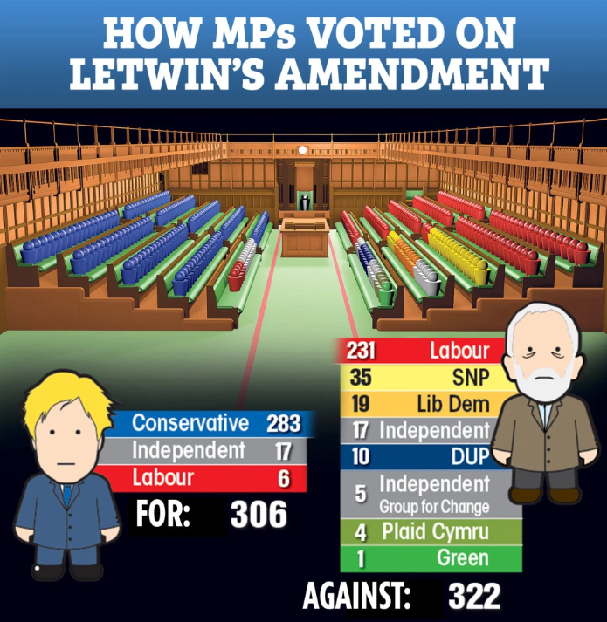
A (NOT SO) HISTORIC SATURDAY SITTING OF PARLIAMENT
Saturday 19 October – fourth time Parliament has ever sat on a Saturday
This was the last opportunity for Parliament to approve the new deal without government needing to request an extension to Article 50.
However some MP’s were worried Parliament would approve the deal and run out of time to complete all stages of the legislation before 31 October, risking a no-deal exit.
As a result an amendment was approved which withholds support for the deal until the draft legislation becomes law. No vote on the deal took place.
AGAINST: 306
FOR: 322

Slide 24
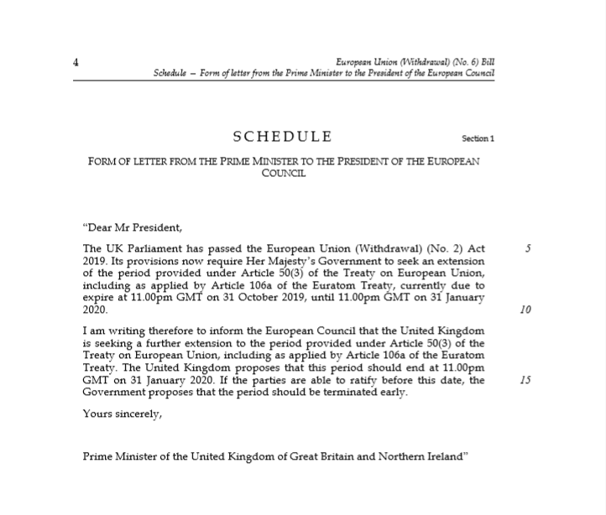
EUROPEAN UNION (WITHDRAWAL) (NO. 2) ACT 2019
Places a duty on government to request an extension until 31st January if, by 19 October:
No new deal has been agreed; and
Parliament has not consented to leaving without a deal
A copy of the letter in the act was sent and left unsigned

Slide 25
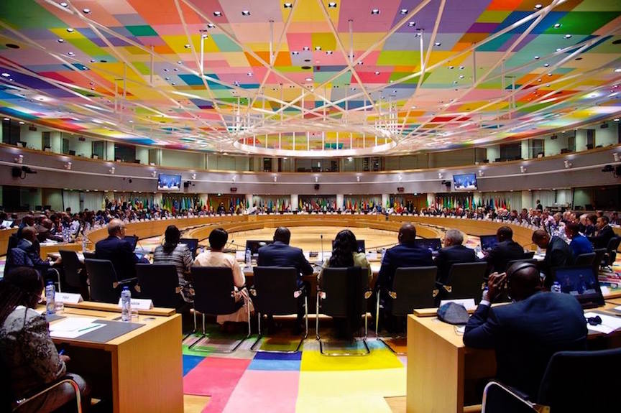
ARTICLE 50 EXTENSION
Art. 50 (3) TEU – Council must “unanimously decide” to extend
Request = 31st January 2020
EU27 agreed to an extension until 31st January

Slide 26
IS NO-DEAL OFF THE TABLE?

Slide 27
IS NO-DEAL OFF THE TABLE?

Slide 28
2020 NO-DEAL?
Could happen on 31st January
Could happen on 31st December
Risks remain
Uncertainty will continue
Prepare for the worst, but hope for the best
Notes:
100 pop up sites will be on routes to key points of exit. A majority of these will be advice stops, there to highlight the information hauliers will need to have on them should they wish to progress through the UK border. However some of these will provide physical support to traders in completing documentation such as customs declarations.
Turn back sites
£300 fines for lorries arriving to the border without being prepared
Other major automotive ports such as Bristol, Grimsby and Immingham, Southampton and Tyne have

Slide 29
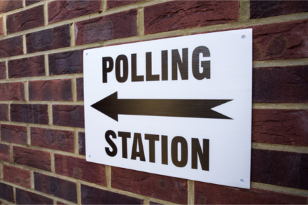
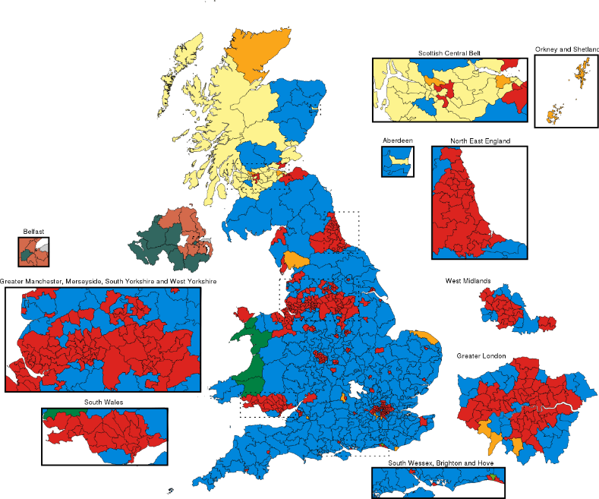
BACK TO THE POLLS
General Election on 12 December
CON: 41% (+8)
LAB: 24% (-)
LDEM: 20% (-3)
BREX: 7% (-3)
GRN: 3% (-1)
via @IpsosMORI 25 - 28 Oct
Notes:
100 pop up sites will be on routes to key points of exit. A majority of these will be advice stops, there to highlight the information hauliers will need to have on them should they wish to progress through the UK border. However some of these will provide physical support to traders in completing documentation such as customs declarations.
Turn back sites
£300 fines for lorries arriving to the border without being prepared
Other major automotive ports such as Bristol, Grimsby and Immingham, Southampton and Tyne have

Slide 30
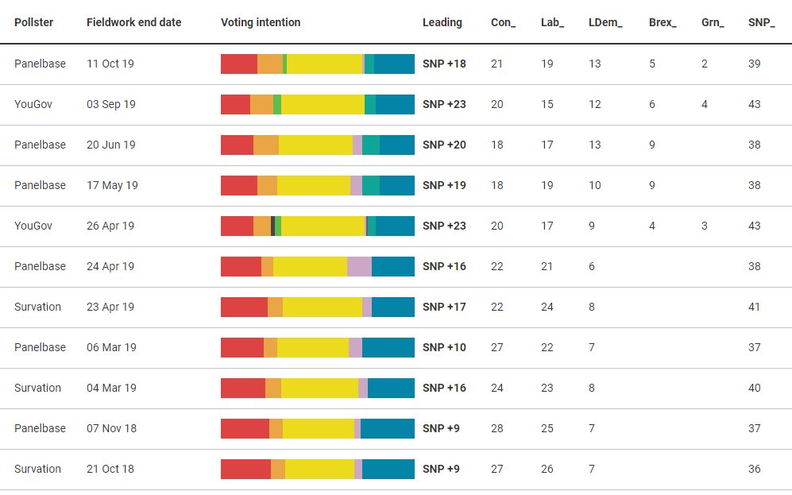
BACK TO THE POLLS
Scottish voting intentions since October of last year have primarily seen shifts from Labour and the Tories to the Lib Dems and the Brexit Party, gifting the SNP leads of around 20pts.

Slide 31
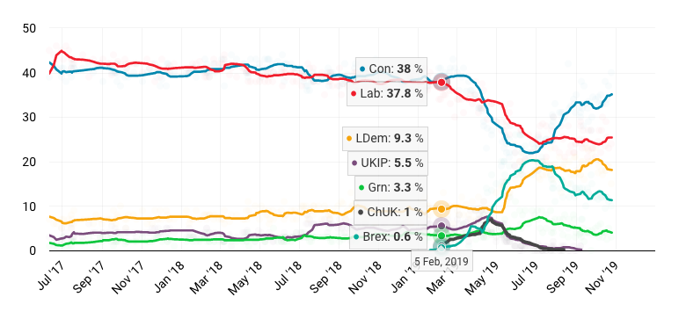
BACK TO THE POLLS

Slide 32
WHO WILL WIN ON 12TH DECEMBER?

Slide 33
Questions and Answers
Please type your question in the Question/Chat box.
Email: memberservices@smmt.co.uk with your questions after this session.
Slides emailed to participants after this session.

Slide 34
Thank you

