Slide 1
Make the most of your time at Meet the Buyer
Luke Hampton
Senior Supply Chain Manager
SMMT
Loreta El-Khatib
Assistant Member Services Manager
SMMT
Lawrence Davies MBE
Automotive Team
Department of International Trade
Download the audio recording here

Slide 2
During presentations (14:00 – 14:30) everyone will be muted so that only the presenters will be heard.
The presentation will be followed by a Q&A session. Click on the hand symbol to show that you have a question.
If you are experiencing any technical problems please call
020 7344 1673.

Slide 3
Contents
Introduction to Automechanika Birmingham – Luke Hampton, SMMT
How to make the most of Meet the Buyer – Lawrence Davies, Department of International Trade
On the day requirements – Loreta El-Khatib, SMMT

Slide 4
Introduction to Automechanika Birmingham
Luke Hampton - Senior Supply Chain Manager
SMMT

Slide 5
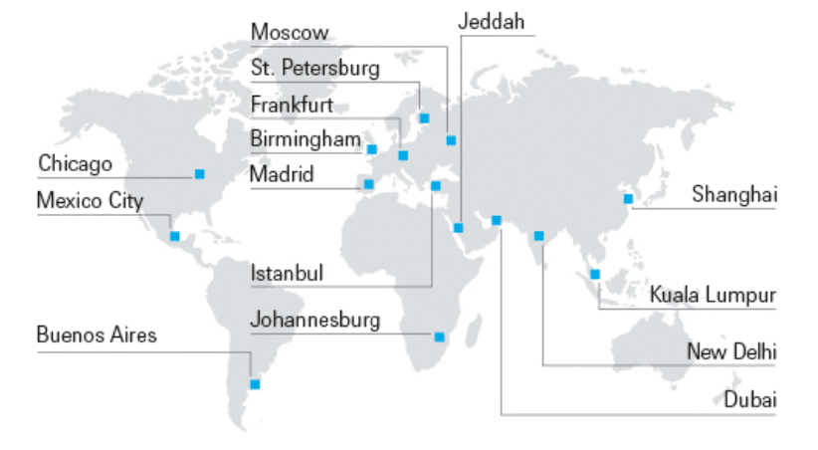
What is Automechanika?
One of the world’s leading international trade show brand
15 existing shows in a global series
16,000 exhibitors; 600,000 trade visitors; 120 trade associations
Primarily aftermarket focused

Slide 6
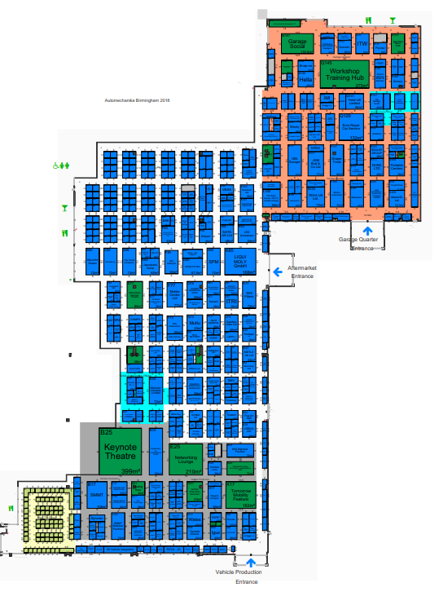
Automechanika Birmingham 2018
500 exhibitors expected
Visitor preregistration is up on last year
New for this year
Vehicle Production Zone
Garage Quarter
Automechanika Birmingham ‘Meetings programme’
SMMT Open Forum will be ‘in-hall’

Slide 7
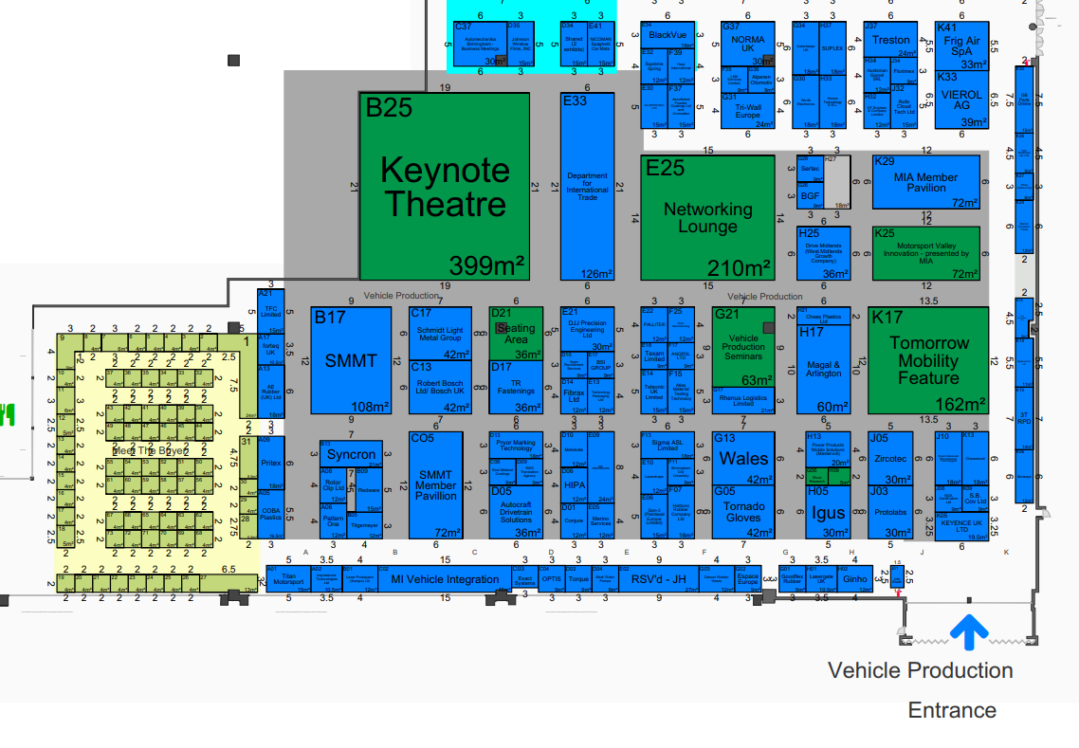
Key locations
Open Forum and
Keynote Theatre
SMMT Stand and
Lounge
Open Forum networking
and lunch area
Vehicle Production
seminar theatre
Meet the Buyer area
SMMT Member Pavilion
(exhibiting members)

Slide 8
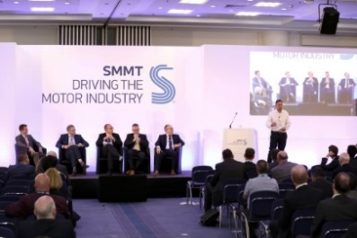
Open Forum – Tuesday 5 June
Located at the Keynote Theatre in Hall 6
+250 delegates expected
Supply chain and Future Technology focussed agenda
Followed by Networking lunch
Speakers announced:
Chaired by Mike Hawes, Chief Executive, SMMT
Tony Walker, Managing Director, Toyota Motor Europe (London).
Andy Haslam, Vehicle Line Director Large Car Platform, Aston Martin.
Steve Collins, NMCL Programme Manager, SMMT
Ben Salama, Managing Director, Accenture Digital.
James Taylor, Managing Director, DriveNow (BMW).
Ben Boutcher-West, Automotive Lead, Bosch.
Tom Westendorp, Business Development Manager Autonomous Driving, NVIDIA

Slide 9
Meet the Buyer
09:30-10:00 – Buyer arrival
10:00-12:30 – MtB meetings (30 mins each)
12:30-13:30 – Lunch break (Lunch @ SMMT Lounge)
13:30-17:00 – MtB meetings (30 mins each)

Slide 10
How to make the most of Meet the Buyer
Lawrence Davies MBE, Automotive Team
Department for International Trade

Slide 11
Be Prepared
Purpose of Meet the Buyer: This event is offering the opportunity for direct contact with potential customer’s commodity leaders
What to Take
Business cards
Company Brochure to leave with the client
Structured Presentation (no more than 8-10 slides)
company history, size, location(s) (one pager)
commodities produced,
current customers,
accreditations,
current QCD performance, design capability etc
The meetings
1-2-1 meetings are 15 or 25mins, with 5 min switch over time. Be on time and be professional. Give thought to where you want to be in the supply chain

Slide 12
Winning business with new customers
As a supplier ….
Adapt
Automotive suppliers with an established competence in one commodity area, seeking to use those abilities to win business in another
Transition
Tier-n suppliers wishing to come into direct Tier 1 business
Translate
Established automotive suppliers trying to win business with a new customer or customer group. Understand that working with new customers is a process of translation. It is important to understand what the opportunity is, the decision process, the terminology and language, culture, sources of data, how to present information and what is open for negotiation.

Slide 13
What’s Your Proposition
The purpose of the meeting is to explore areas of mutual interest and opportunity.
Why Source Through Us? – Keep it concise and brief (1-2 slides)
What's your unique selling point (USP)
Understand and communicate your competitive position
Demonstrate general competence, specific expertise, significant differentiation
Have a plan to interface with the customer’s engineering office wherever it is based
Consider partnerships or collaborations
Have a realistic and credible expectation and give thought to where you want to be in the supply chain

Slide 14
The key phases in winning a nomination
Translating potential into new business
Nomination
Analysis and Negotiation
Request for Quotation
Bidder List
Pre-qualification
Getting known

Slide 15
Quoting
Be prepared for…
Confirmation of producability
Supplier Development Cost
Tooling Analysis
Logistics Analysis
Patents
Warranty Agreement
IPTC (international purchasing terms and conditions)
Confidentiality Agreement
Spare parts standards
Spare parts manual
Confirmation of Concept Maturity Level

Slide 16
On the day requirements
Loreta El-Khatib, Assistant Member Services Manager
SMMT

Slide 17
What to expect on the day
Appointments take place within Hall 6
Either 15, 25 or 55 min. Times are subject to change but we’ll do our best to avoid this.
Please remain on time and respect the privacy of those meetings before you.
Find your scheduled appointments in the SMMT events app under Appointments > My schedule > 6 June
Search ‘attendee hub’ in your app store, then search for ‘SMMT Meet the Buyer’.
Speak to staff on the SMMT stand (B17), if you are unsure of where you are meant to be.

Slide 18
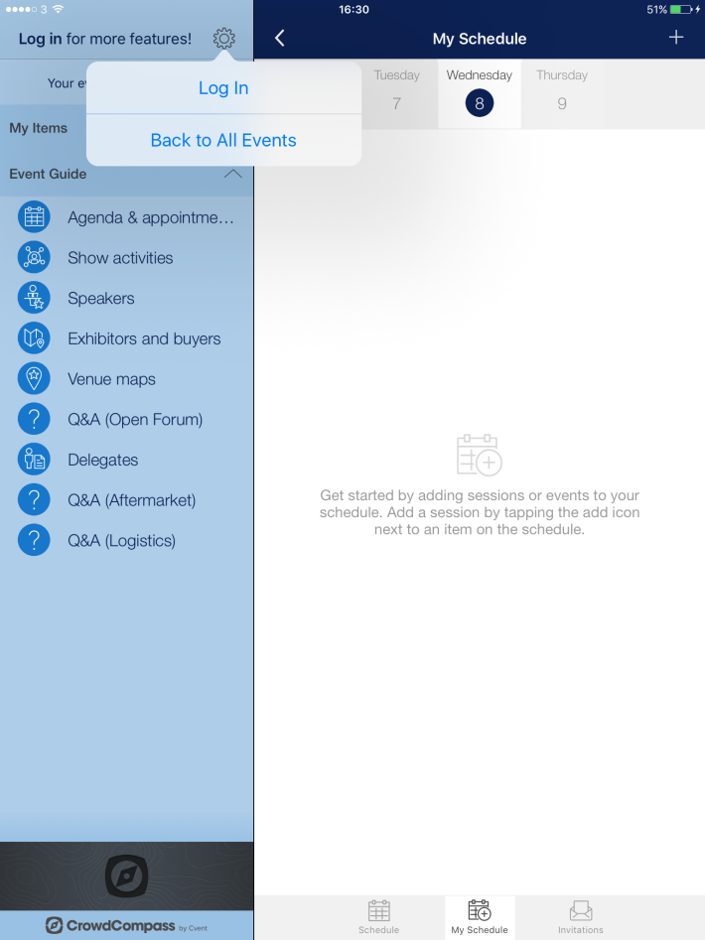
SMMT events app

Slide 19
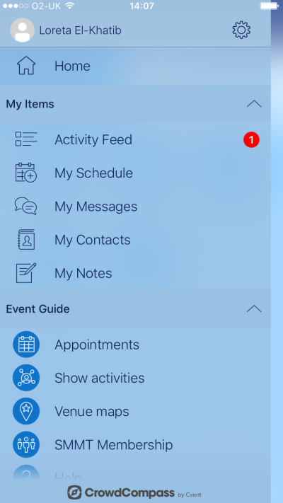
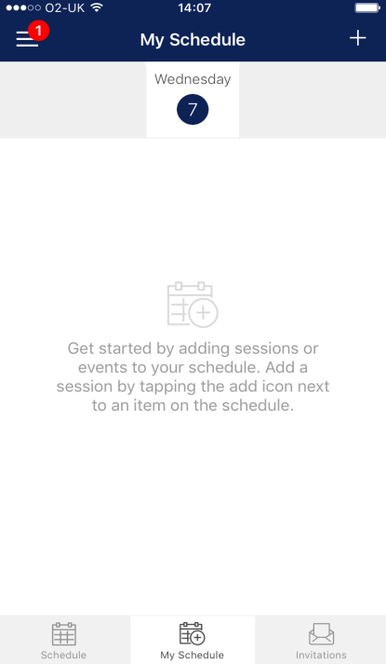
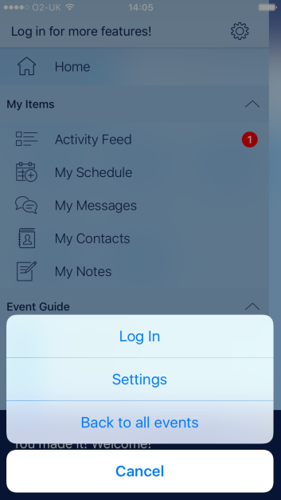
Allow the app to refresh with appointments!
Your scheduled meetings and buyer locations!

Slide 20
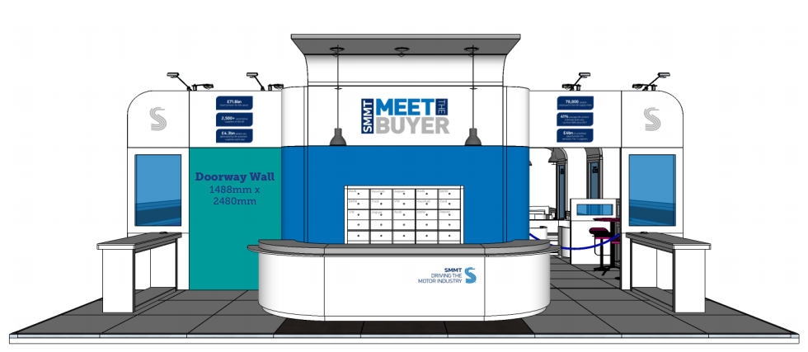
What to expect on the day
Meeting requests process
Invitations have been sent and we’ll continue to send in next couple of days
Meeting request forms will be available from the SMMT stand on Tuesday and Wednesday morning. These will be collected at:
12:00 and 15:00 on Tuesday
5 mins to the hour on Wednesday until 12:00
All will be presented to the buyers however Members will be prioritised where schedules are almost full
Notes:
If you submitted your profile it has been sent to the buyers in advance to schedule one to one appointments
Some invitations have been sent and we’ll continue to send over the next couple of weeks
If you have already booked interest through our ticket registration, Cvent, you should join us for the morning session even if you do not have appointments confirmed yet.
Meeting request forms will be available from the SMMT stand on Tuesday and Wednesday morning. These will be collected at 1
12:00 and 15:00 on Tuesday
5 mins to the hour on Wednesday until 14:00
All will be presented to the buyers however Members will be prioritised where schedules are almost full

Slide 21
What to expect on the day
Buyers have the final say, SMMT cannot schedule a meeting unless instructed to by the buyers
Buyer schedules may be full, but suppliers contact details will be shared where requested by the buyer after the event
Make use of the networking opportunity, visit the exhibitor stands and seminars taking place during the day.
Speak to SMMT staff available on the stand and around the venue.
Make sure your phone is switched on and check for updates on your meeting requests/cancellations
Wifi codes will be made available in SMMT hot spots around the hall
Please complete feedback forms which will be sent to you following the events.

Slide 22
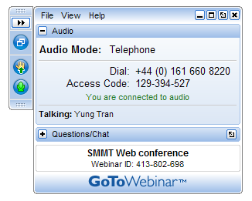
Questions and Answers
Please type your question in the Question/Chat box.
Email: memberservices@smmt.co.uk with your questions after this session.
Slides emailed to participants after this session.

Slide 23
Thank you

